Slide 1

Project Title -Doctor Visits Analytics
Student Name : Shruti Mallikarjun Halle
College Name : SNDT Arts and Commerce College For Women Pune
AICTE STU ID : STU676d48447d8341735215172

Slide 2

PROBLEM STATEMENT
Hospitals and health planners need to understand why some people visit doctors more often than others, but raw survey data does not show the patterns clearly.
This project analyzes 5,190 survey records to find which factors (health condition, age, gender, income, insurance) are most related to the number of doctor visits.

Slide 3
Project Description
- Analyzed a health survey dataset of 5,190 people (doctor visits in the past 2 weeks)
- Cleaned the data: removed the index column, converted age and income to real units, checked for missing values
- Created age groups and a visited / not visited flag
- Explored distributions, group averages, correlations and insurance coverage using charts
- Built an interactive Looker Studio dashboard with gender and age group filters
Key findings:
- 80% of people had no doctor visit in the 2-week window
- Illness and chronic conditions drive visits the most (0.08 visits with no illness vs 0.81 with 5 illnesses)
- Women (0.36) and older people (60+: 0.43) visit more
- Income and private insurance make very little difference

Slide 4

WHO ARE THE END USERS?
- Hospital and clinic administrators: plan staffing and appointment capacity
- Public health officials and policymakers: identify groups with high or low healthcare use
- Health insurance providers: understand utilization patterns
- Healthcare analysts and researchers: use the insights for further study

Slide 5

Technology Used
- Python: Pandas, NumPy for data cleaning and analysis
- Matplotlib, Seaborn for data visualization
- Jupyter Notebook for analysis
- Looker Studio for the interactive dashboard
- GitHub for version control and sharing

Slide 6
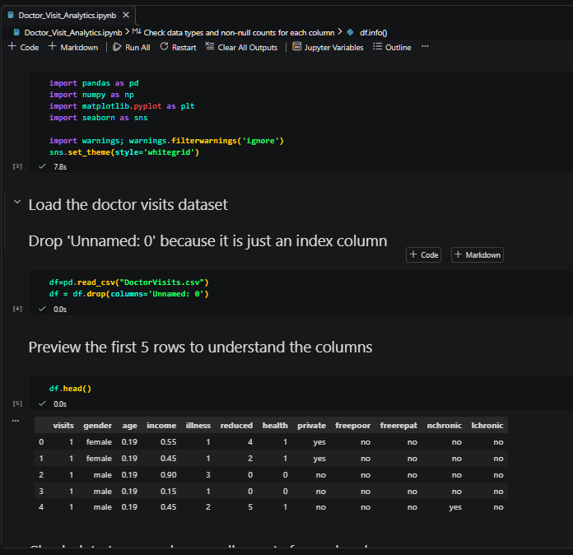
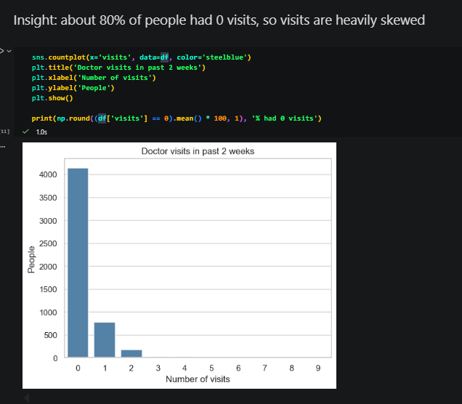
RESULTS

Slide 7
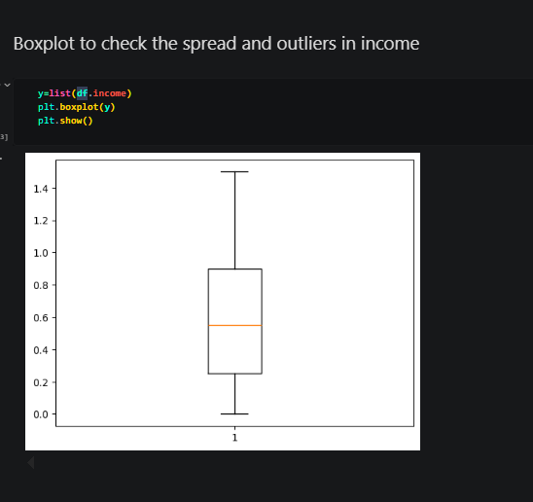
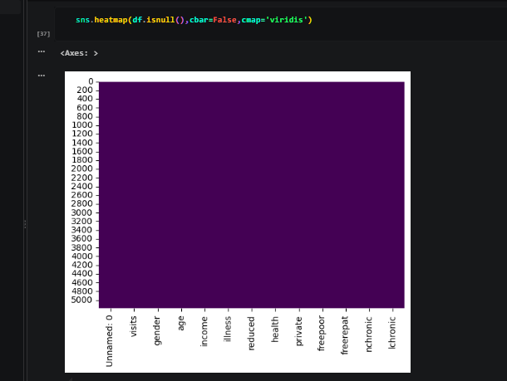
RESULTS
https://colab.research.google.com/drive/18ROOwN9EsDG8xVDD-x3q3lzFnzZSV7Iw?usp=sharing

Slide 8
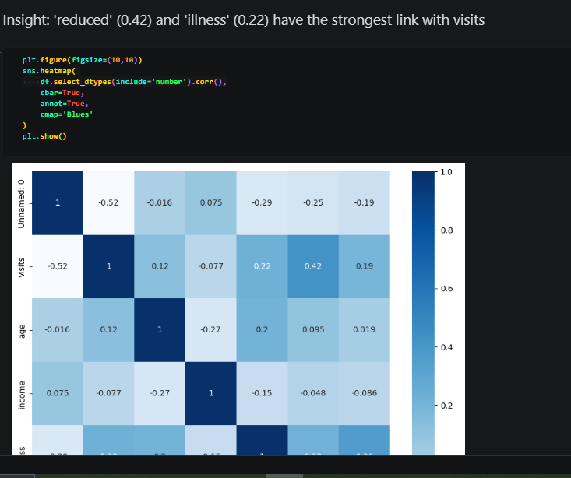
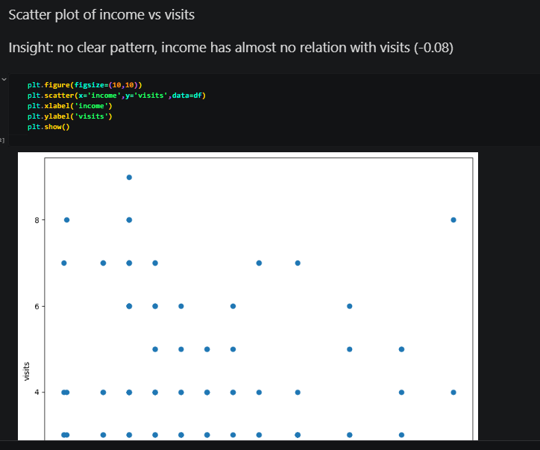
RESULTS

Slide 9
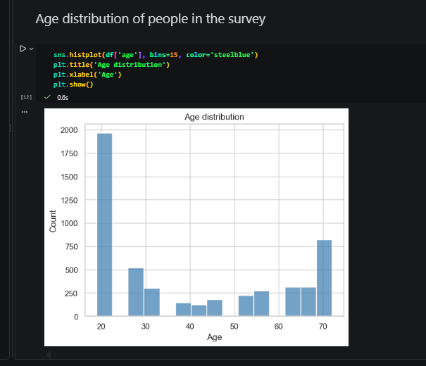
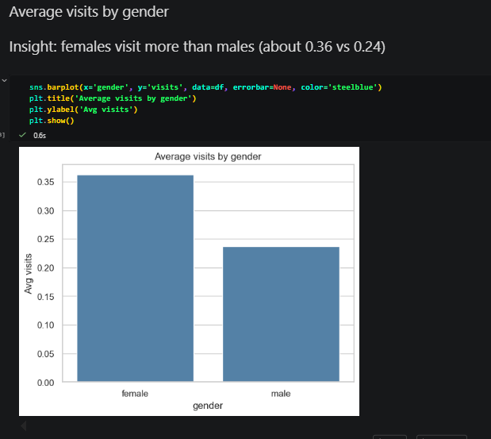
RESULTS

Slide 10
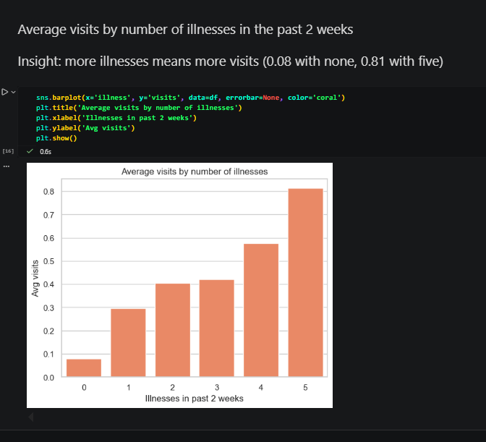
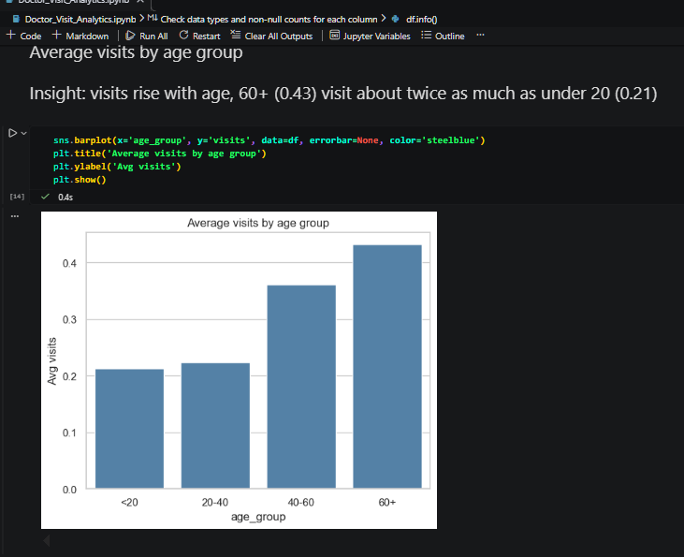
RESULTS

Slide 11
Future scope
- Add predictive modeling (e.g., classification) to predict who is likely to visit a doctor
- Use more recent and larger datasets to check whether the patterns still hold today
- Add more dashboard pages, such as insurance coverage analysis and income-level comparisons
- Add region and time-based data to track trends over a full year, not just 2 weeks
- Include more detailed health data (e.g., specific conditions, lifestyle factors) for deeper insights
- Automate the data pipeline so the dashboard updates with new data

Slide 12
GitHub Link
https://github.com/Shruti-Halle/Doctor-Visits-Analytics

Slide 13
Thank you
Shruti Halle | shrutihalle2@gmail.com
https://www.linkedin.com/in/shruti-halle/
https://github.com/Shruti-Halle/Doctor-Visits-Analytics

